Slide 1

CHATBOT ASSISTANT SYSTEM
Presented By:
MANAV KATHURIA
(2100680110030)
NIKHIL RANA
(2100680110033)
Under the Guidance of:
MR. RAHUL SINGH
Department of Information Technology
Meerut Institute of Engineering & Technology, Meerut (U.P.)
Notes:
₁

Slide 2

TABLE OF CONTENT
Abstract
Introduction
Problem Statement
Survey
Methodology
DFD
Experimental Details
Consultations
References

Slide 3
ABSTRACT
This PowerPoint presentation provides a comprehensive exploration of chatbot systems, their evolution, and their transformative impact on user interactions. The presentation begins with an introduction to chatbots, outlining their definition, purpose, and the underlying technologies that power them. It delves into the history of chatbot development, highlighting key milestones and breakthroughs.
The core functionalities and capabilities of chatbots are elucidated, showcasing their versatility across various industries such as customer service, healthcare, e-commerce, and more. The presentation emphasizes the role of natural language processing (NLP) and machine learning in enhancing chatbot intelligence and adaptability.

Slide 4
Introduction
A Chatbot is a piece of technology that allows a computer program to communicate with people just like
conversing through text messaging using a natural language, say English, to accomplish specific tasks. A
chatbot is also known as an artificial conversational entity (ACE), chat robot, talk bot, chatterbot or
chatterbox. The first chatbot was made in the year 1966 at the MIT AI Laboratory, named Eliza whose
purpose was to give an accurate simulation of a human conversation. It was a simple program designed
to impersonate a psychotherapist and give out predefined responses to user queries

Slide 5
However, the code base was exhaustive enough to take into account several possible queries and the
chatbot was capable of passing the Turing Test, a test designed to check out whether a computer program
could pass as an actual human being or not. Chatbots today, have become a lot more advanced since then,
able to answer substantially complex queries and have expanded capabilities such as voice interaction and machin learning . Chatbots can broadly be classified into two types:
Simple Chatbots
Smart Chatbots

Slide 6
Problem Statement
This project seeks to address this problem by developing an intelligent and user-friendly Chatbot System. The challenge lies in designing and implementing a system that can understand natural language, interpret user queries accurately, and provide meaningful responses. Additionally, the system should be versatile enough to be integrated into diverse applications, enhancing user experiences and efficiency across different domains such as customer support, information retrieval, and task automation. The objective is to create a robust Chatbot System that not only addresses the current shortcomings in communication interfaces but also serves as a scalable and adaptable solution for a wide range of user interactions.

Slide 7
SURVEY
Section 1: Demographics
1.1. Age:
Under 18
18-24
25-34
35-44
45-54
55 or older
1.2. How often do you use chat or messaging apps?
Rarely
Occasionally
Frequently
Always

Slide 8
Section 2: Chatbot Experience
2.1. Have you used a chatbot before?
Yes
No
2.2. Rate your overall satisfaction with past chatbot experiences.
Satisfied
Neutral
Dissatisfied
Section 3: Expectations
3.2. How comfortable are you with interacting with a chatbot for various tasks?
Very Comfortable
Comfortable
Neutral
Uncomfortable
Very Uncomfortable
Conclusion: Thank you for your valuable input! Your feedback is crucial in improving our Chatbot System.

Slide 9
Methodology
Objective Definition:
Define the specific objectives of the Chatbot System mini project, focusing on a targeted set of functionalities to be implemented within the project's scope.
User Requirements Gathering:
Conduct a brief survey or interviews to understand user expectations and requirements for the Chatbot System in the context of the mini project.
Technology Selection:
Choose a suitable chatbot development framework or platform based on the project's constraints, considering factors such as simplicity, ease of integration, and available documentation.
System Design:
Develop a simplified system architecture and design document outlining the key components, user interface, and integration points for the Chatbot System.
Prototyping:
Create a basic prototype to test core functionalities and gather initial feedback, allowing for quick iterations and improvements.

Slide 10
Development:
Implement the Chatbot System, focusing on the identified functionalities and ensuring alignment with the mini project's objectives.
Testing:
Conduct basic testing to ensure the functionality, usability, and responsiveness of the Chatbot System within the constraints of the mini project.
User Feedback:
Gather user feedback through a brief usability test or survey to identify areas for improvement and refinement.
Adjustments and Iterations:
Make necessary adjustments based on user feedback, refining the Chatbot System in an iterative manner.
Documentation:
Prepare concise documentation outlining the implemented functionalities, system architecture, and any additional information relevant to the mini project.

Slide 11
Deployment:
Deploy the Chatbot System in the mini project environment for further testing and evaluation.
Evaluation:
Evaluate the success of the Chatbot System based on predefined criteria, such as user satisfaction and functionality achievement within the mini project's scope.
Final Adjustments:
Make final adjustments based on the evaluation results, ensuring that the Chatbot System meets the objectives of the mini project.
Conclusion:
Summarize the methodology, highlighting key steps taken to develop and refine the Chatbot System within the constraints of the mini project.

Slide 12
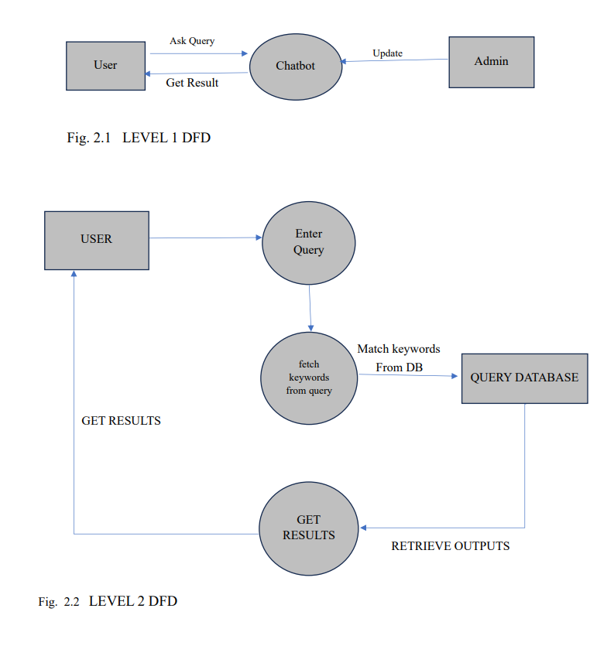
DFD

Slide 13
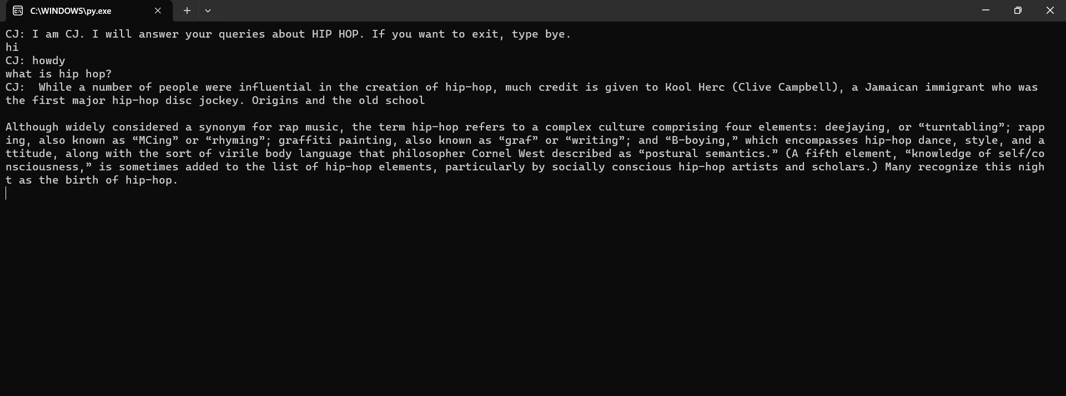
Sample Screenshot

Slide 14
EXPERIMENTAL DETAILS
Data Collection:
Collect a set of diverse user queries and corresponding responses to form the basis for training and testing the Chatbot System.
Training Data:
Utilize a small dataset for training the Chatbot's natural language processing (NLP) model, ensuring relevance to the targeted domain of the mini project.
Chatbot Implementation:
Develop the Chatbot System, incorporating the trained NLP model and integrating it into a user-friendly interface.
Usability Testing:
Conduct usability testing with a select group of users to assess the system's ease of use, effectiveness in understanding queries, and overall user satisfaction.
User Feedback:
Collect user feedback through a brief survey or interviews, focusing on their experience with the Chatbot System, any encountered issues, and suggestions for improvement.

Slide 15
CONSULTATIONS
Consultaions for Chatbot System
Stakeholder Meeting:
Define project objectives and expectations with stakeholders.
User Feedback Sessions:
Gather insights from potential end-users on preferences and expectations.
Technology Consultation:
Validate technology choices with technical experts for optimal development.
Iterative Feedback Loops:
Regularly share prototypes, gather feedback, and make adjustments.

Slide 16
User Acceptance Testing (UAT):
Collaborate with end-users for final system validation.
Final Presentation and Approval:
Showcase the Chatbot System, present findings, and seek approval.
Conclusion:
Summarize collaborative efforts and insights gained from consultations.

Slide 17
References
https://www.britannica.com/art/hip-hop
https://github.com/
https://www.w3schools.com/
https://www.wikipedia.org/

